Slide 1
Decision Model for Anti-Virus Software Selection
-To help common people in choosing the right Anti-Virus
Decision and Risk Analysis
SYST 573
George Mason University Final Project Presentation
May 06, 2019
Sravya Pagadala
Nikitha Linguthla
Gurunath Pooja Jawalker

Slide 2
Project Motivation and scope
We have formulated a decision-making model for antivirus software consumer. We present here, our implementation of the decision analysis concepts and techniques learned in this class.
Identifying which factors that need to be considered in choosing antivirus software ,organize and present Objectives, explore alternatives and find ways to quantify the alternatives in order to make a better decision for an antivirus software selection.

Slide 3
Specific exclusions from the scope
As this project targets to help common people we choose to exclude the evaluation concern – “How does the antivirus software work?”
We don’t wish to categorize which software to use based on its functionality such as –
Is it a network level protection technology with Intrusion Prevention layer ?
Is it a File based protection?
Is it a Reputation based protections?
Is it a Behavior based protection?

Slide 4
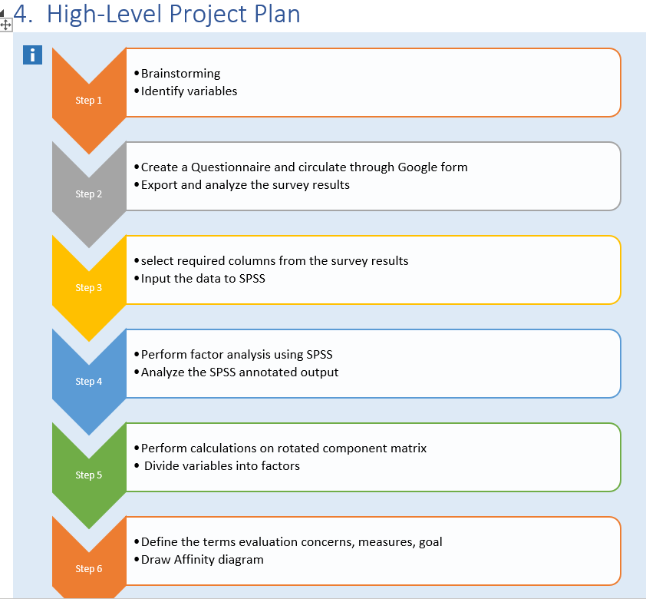
High - Level Project Plan

Slide 5
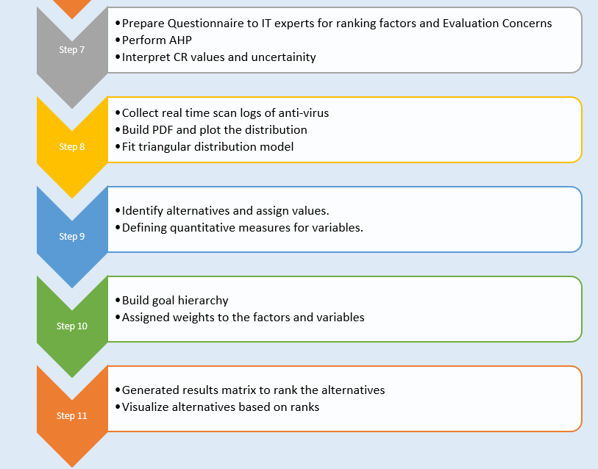

Slide 6
Brainstorming and identifying variables
Online rating & feedback
Hard disk space usage
Customer care service
Schedule a scan feature
Scan logs reports availability
Multiplatform, multi device licenses
Try before you buy option (try a month for free)
Malware detection rate
Privacy Filter
Parental controls ( block access to certain sites unsuitable for children)
File Shredders (remove all electronic traces of infected file)

Slide 7
Spam Filters
Frequency and regularity of updates for software
Installation setup ease
No excessive memory use (A light touch that won't slow you down.)
Anti-worm, Anti Trojan and Antispyware
Full System Scan (Checks all boot records, files, and running processes )
Subscription Price
Data and identity protection
Scan speed and accuracy
User friendly (See how easy the software is to use)
Internet security
Loading speed

Slide 8
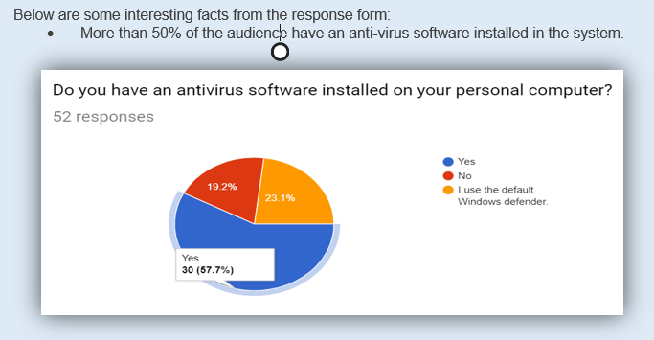
Data Acquisition
We have asked a set of questions in the survey using Google forms and 52 responses are exported for further analysis. All the responses will be contributing data to build the decision model which benefit common people to make a better decision for selecting antivirus software.

Slide 9
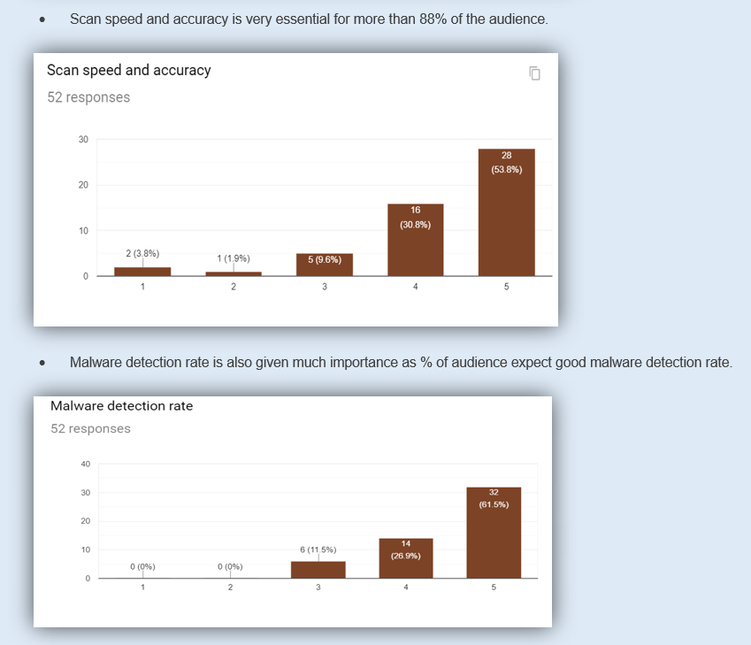
Interesting results from survey

Slide 10
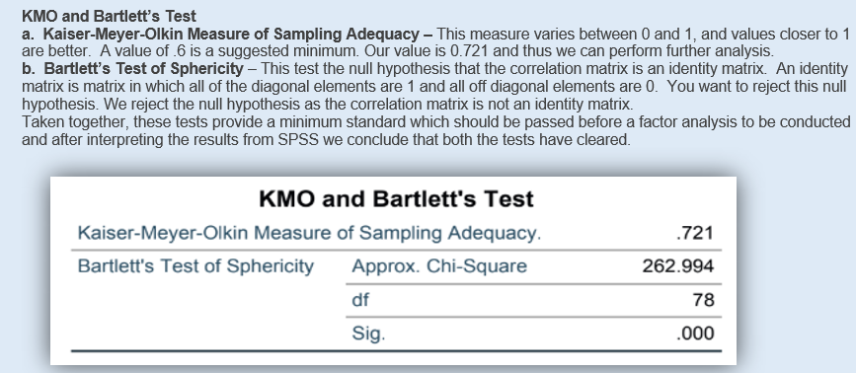
Factor Analysis using SPSS

Slide 11
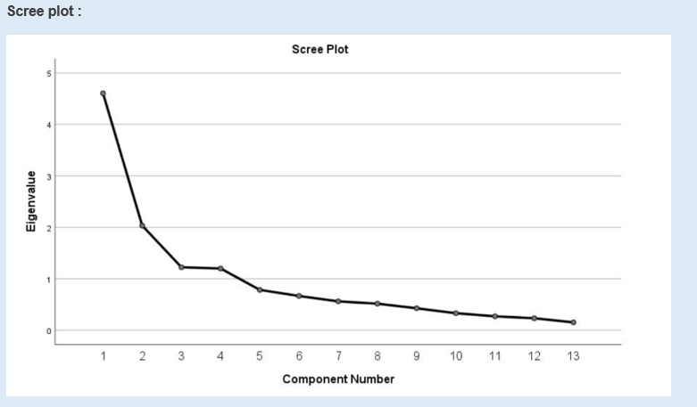
Scree plot graphs the eigenvalue against the factor number.

Slide 12
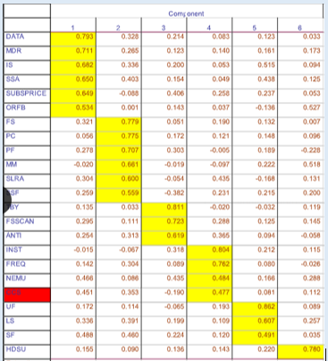
Rotated Component Matrix
Thus so far, we concluded that our 13 variables probably measure 4 underlying factors. But which items measure which factors?

Slide 13
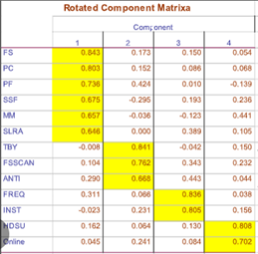
After 11 iterations , this is the calculated rotated component matrix :

Slide 14
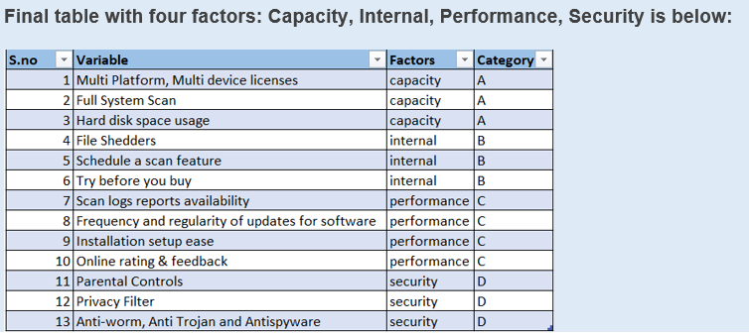

Slide 15
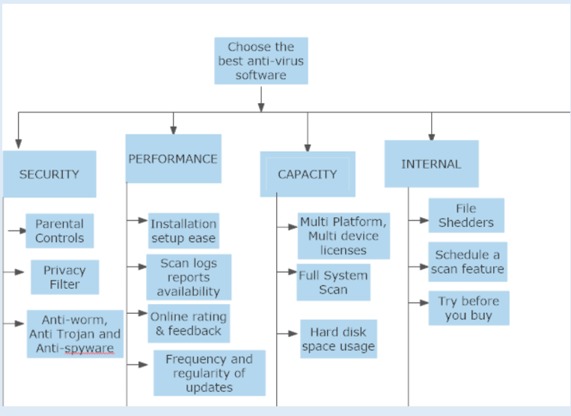
Affinity Diagram

Slide 16
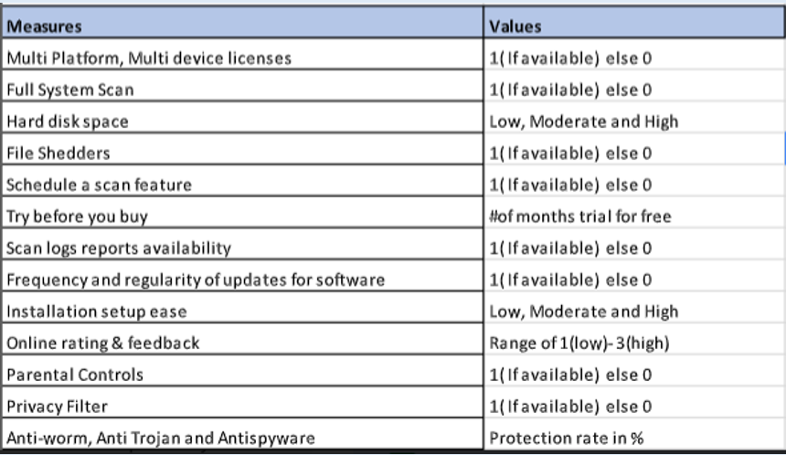
Measures Identified

Slide 17
Identify Alternatives
Alternatives | Symantec end point encryption | Kaspersky | Windows Defender (Pre-Installed) | Bitdefender Internet Security
Multi-Platform, Multi device licenses | 1 | 1 | 0 | 1
Full System Scan | 1 | 1 | 1 | 1
Hard disk space | Moderate | Moderate | Moderate | Low
File Shedders | 1 | 1 | 0 | 1
Schedule a scan feature | 1 | 1 | 1 | 1
Try before you buy | 2 | 2 | 99999 | 6
Scan logs reports availability | 1 | 1 | 1 | 1
Frequency and regularity of updates for software | 1 | 1 | 0 | 1
Installation setup ease | Moderate | Moderate | Low | Moderate
Online rating & feedback | 2 | 2 | 3 | 3
Parental Controls | 0 | 1 | 1 | 1
Privacy Filter | 0 | 1 | 0 | 1
Anti-worm, Anti Trojan and Antispyware | 99.98% | 99.88% | 99.98% | 99.99%

Slide 18
IMPLEMENTINGANALYTIC HIERARCHY PROCESS (AHP)
STEP 1
Hierarchy of goal, criteria, sub-criteria and alternatives. the determination of the criteria
STEP 2
Data are collected from experts or decisionmakers corresponding to the hierarchic structure
STEP 3
The pairwise comparisons of various criteria generated
STEP 4
The principal eigenvalue and the corresponding normalized right eigenvector of the comparison matrix were calculated
STEP 5
The consistency of the matrix of order n is evaluated. Consistency Index and consistency ratio were calculated.
STEP 6
The rating of each alternative is multiplied by the weights of the sub-criteria and aggregated to get local ratings

Slide 19
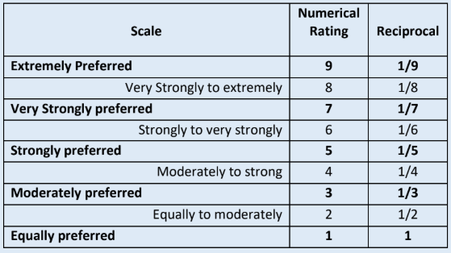
STEP 2
Data are collected from experts or decisionmakers corresponding to the hierarchic structure

Slide 20
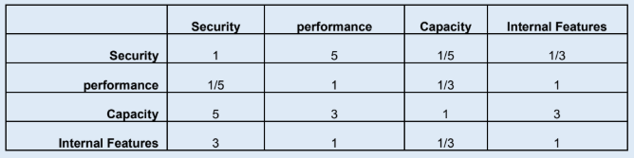
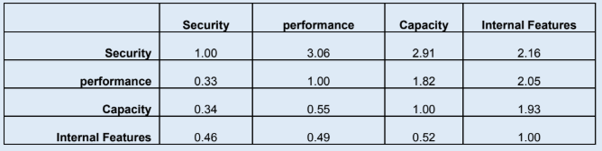
STEP 3
The pairwise comparisons of various criteria generated

Slide 21
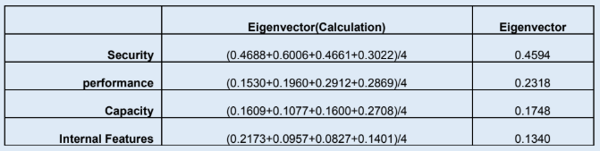
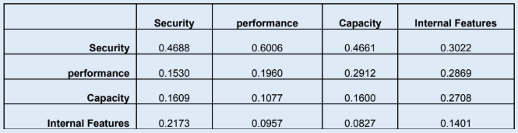
STEP 4
The principal eigenvalue and the corresponding normalized right eigenvector of the comparison matrix were calculated

Slide 22


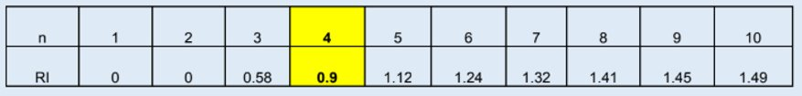

STEP 5
The consistency of the matrix of order n is evaluated. Consistency Index and consistency ratio were calculated.

Slide 23
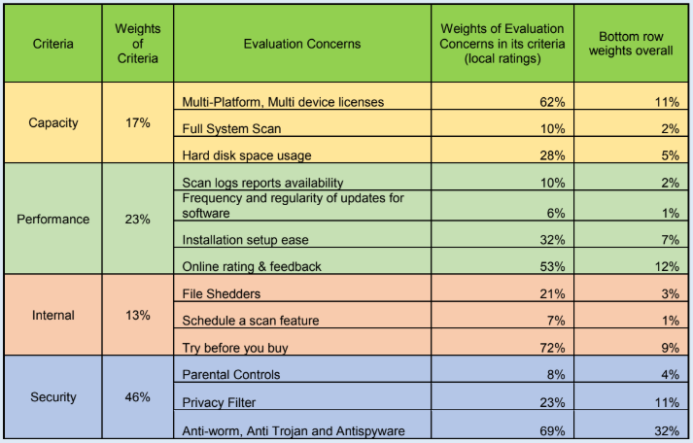
STEP 6
The rating of each alternative is multiplied by the weights of the sub-criteria and aggregated to get local ratings

Slide 24
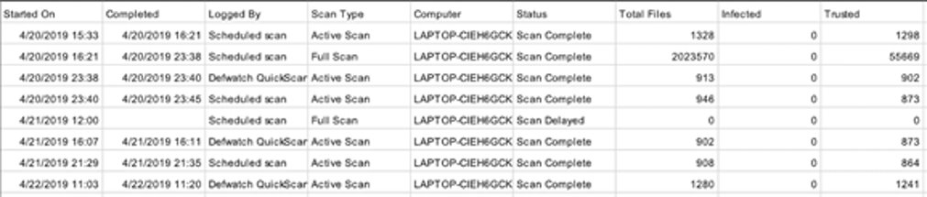
Triangular Distribution
For real time experience we took scan log from Symantec Anti-Virus software extracting log into a csv file. CSV file contains the details of start time of scan, end time of scan, logged by details, type of scan, scan status, Total files that got scanned, trusted files. Below is the snapshot of csv file of scan logs.

Slide 25
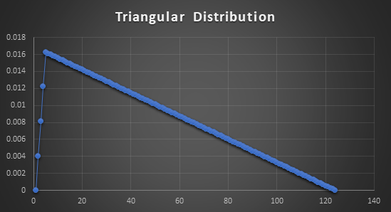
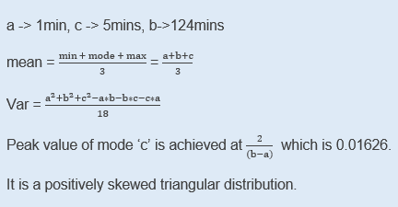
Calculations :

Slide 26
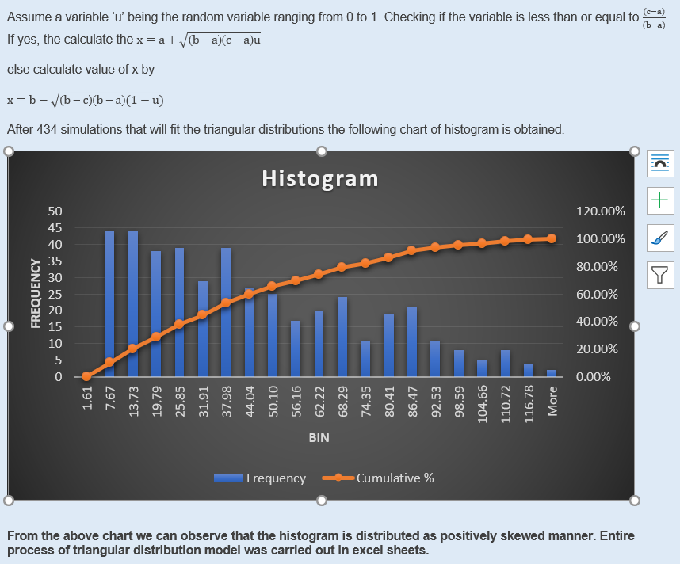
Fitting the triangular distributed model

Slide 27
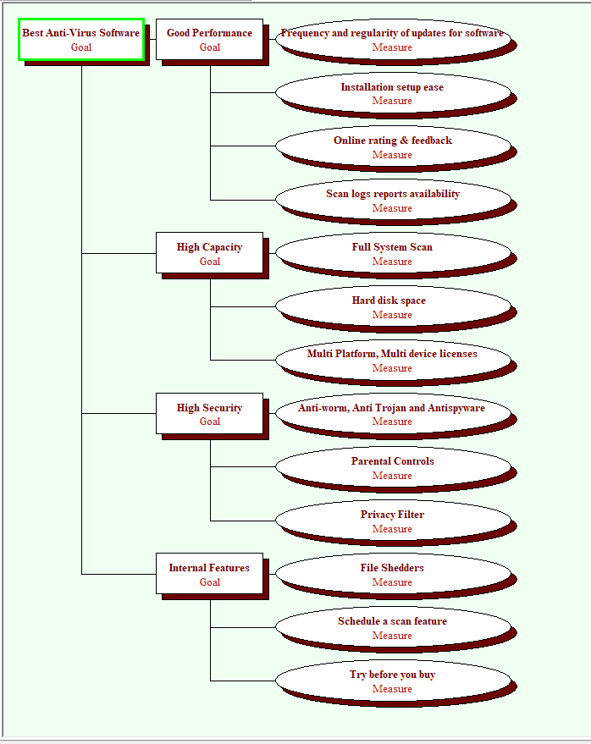
Goal Hierarchy Diagram
Tool: Logical Decisions for Windows
•Created and organized the goals (objectives)
•Defined and placed the measures under the appropriate goals and assigned ranges for the numerical variable
•Built Goal Hierarchy and assigned calculated weights to the factors and variables.

Slide 28
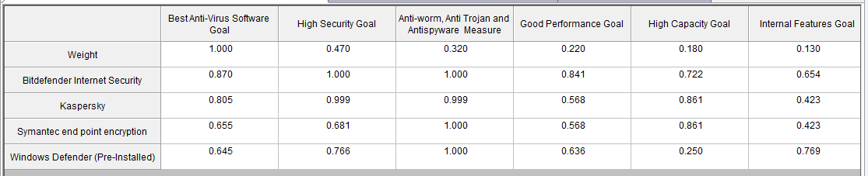
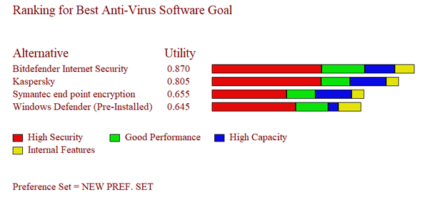
Alternatives Ranking
Ranking of alternatives for Best Anti-Virus Software shows that following ranks:
Bitdefender Internet Security- 87%
Kaspersky- 80.5%
Symantec End Point Encryption- 65.5%
Windows Defender(Pre-Installed)- 64.5%
The diagram also gives how much each individual goal is affecting the ranking of each alternative. Security plays a very important role in how an alternative is selected.

Slide 29
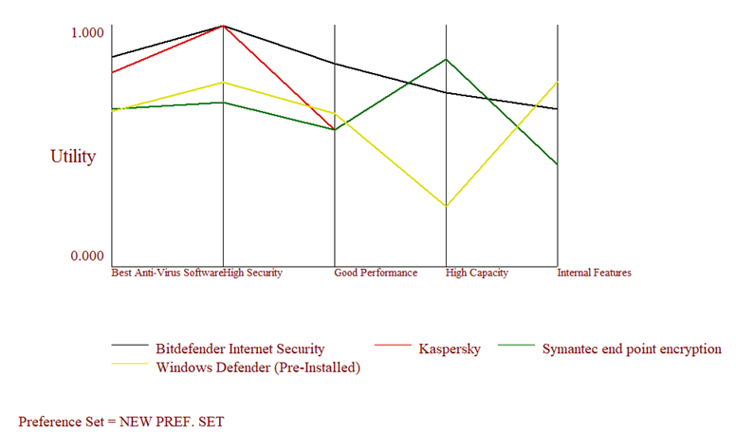
Ranking for each individual goal for the alternatives

Slide 30
THANK YOU

